Slide 1
Soil as a Resource

Slide 2
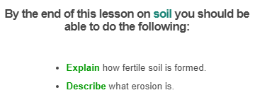
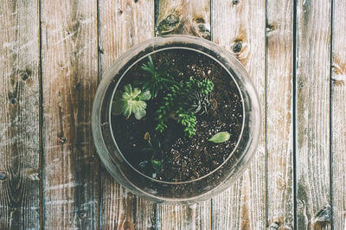

Slide 3
How is soil made? Believe it or not, it comes from solid rocks that are broken down over time!
Weathering and erosion are the processes that break down and move rocks on the Earth's surface. They work together to turn rocks into sediment, then into soil.

Slide 4
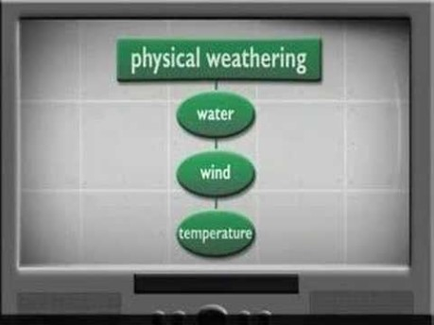

Slide 5
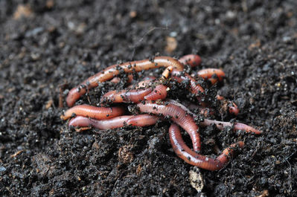
Erosion carries small fragments of rock into low-lying areas that are quite flat. Here they are dumped or deposited.
As the dumping goes on, the tiny pieces of rock pile up and form layers. These layers are infertile soil.
To make them fertile (suitable for growing crops) some organic matter must be added! That means there must be things living in the soil, like worms and insects.

Slide 6
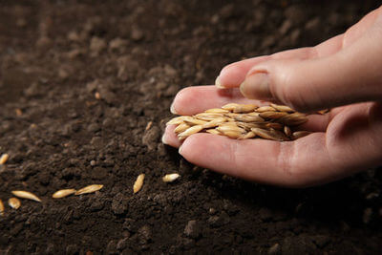
Why is soil so important?
In Australia, we need fertile soil to grow our crops in - vegetables, fruits and other plants. However only 4% of the soil in this country is fertile enough! The other 96% is unusable.
It's vital that we conserve the soil we have, so we can keep growing food.

Slide 7
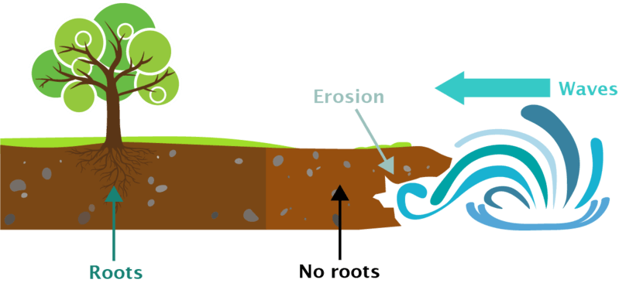
Unfortunately, one of the problems facing soil conservation is the process of erosion itself.
As we know, this is one of the processes that creates soil - so what's going on?
Well, when soil is held together by plant roots, it is stable and can resist erosion. But if the plants are gone, the soil is loose and can be carried away by the wind or waves. This is what the diagram below shows:

Slide 8
